Slide 1
You aren’t going to need it

Slide 2
AGENDA
YAGNI principle
Why it matters?
Examples
References

Slide 3
YAGNI principle
You aren’t going to need it (YAGNI) - is a principle of extreme programming that states a programmer should not add functionality until deemed necessary.
There are a number of reasons why this principle exist. Firstly, it maximizes the amount of unnecessary work the left undone, which is a great way to improve productivity and product simplicity. Features are expensive: both to develop, to maintain and for users to learn and navigate around. So, features that aren’t really necessary are a huge source of waste.
Always implement things when you actually need them, never when you just foresee that you need them.

Slide 4
Why it matters?
Until some functional is not really necessary, it is difficult to fully anticipate what it should do and test it. If the new functionality is not thoroughly tested, it may not work properly when it is needed later.
It takes that could be spent on adding, testing, and improving the required functionality.
New functionality limits what can be done in the future, so unnecessary functionality may later prevent you from adding new functionality.
Adding new functionality can lead to the desire for even newer functionality, resulting in a snowball effect.
Software becomes more complicated.

Slide 5
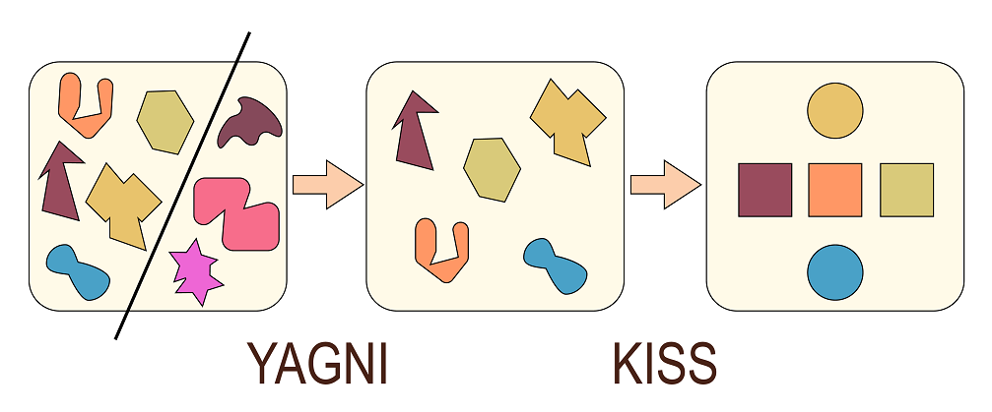
Examples

Slide 6
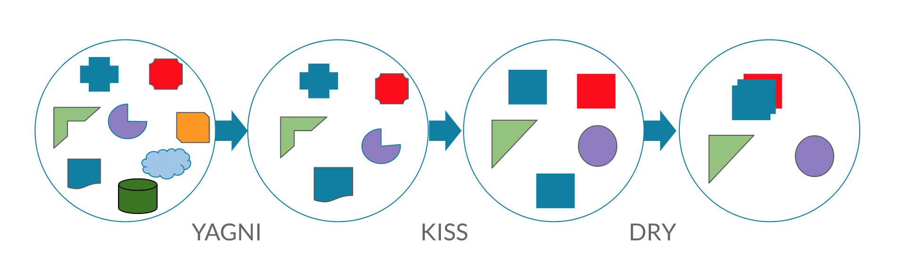

Slide 7
References
https://deviq.com/yagni/
https://en.wikipedia.org/wiki/You_aren%27t_gonna_need_it
https://martinfowler.com/bliki/Yagni.html
https://whatis.techtarget.com/definition/You-arent-gonna-need-it

